Slide 1
MVC
With Me: Cody

Slide 2
How we start writing server-side code:
We use basic Separation of Concerns
Javascript in one file (server.js)
Public folder has:
CSS (style.css)
Html (index.html)
“Good enough” for small sites/projects

Slide 3
What happens as our get larger?
We add .html files new html files for different pages
We might add different .css files to handle stylistic changes
We still use one js file to handle all the functional elements that deliver our content?

Slide 4
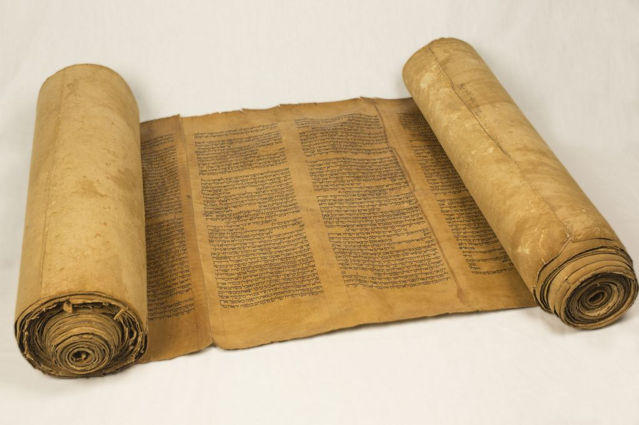
Why a single server.js is a bad idea
Handling routing, rendering, listening, and responding for dozens (if not hundreds) of pages with different CRUD methods means your server.js gets very large very quickly
Debugging can be difficult, even if well organized
A single typo can take down the entire server
Collaboration can be very difficult
It’s like writing a 500-page book on a scroll.

Slide 5
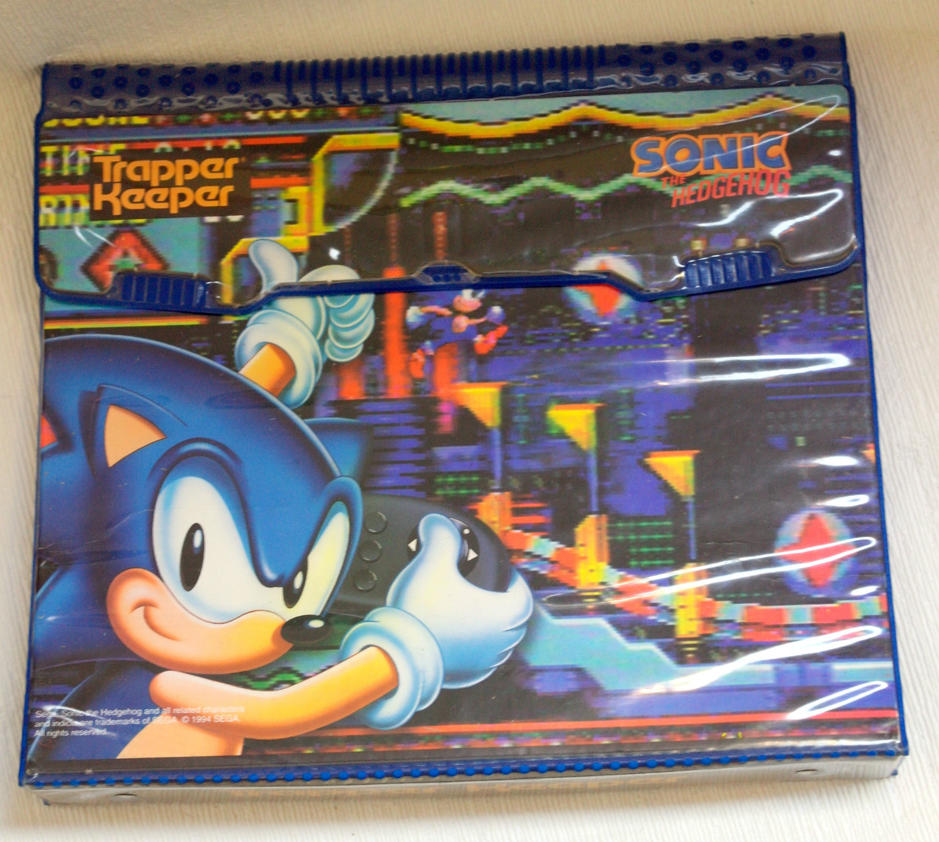
What would be better?
We want something like Separation of Concerns, but just for our JS
Should be easy to split up so a team can collaborate on it
These pieces should be “abstractable” (i.e. have interfaces) so that they can be used without worrying about the underlying code
They should also be logically organized such that the pieces are easy to find and like items are all held together
More like writing the chapters of your 500-page book in their own Trappers and storing them in your sweet Trapper Keeper

Slide 6
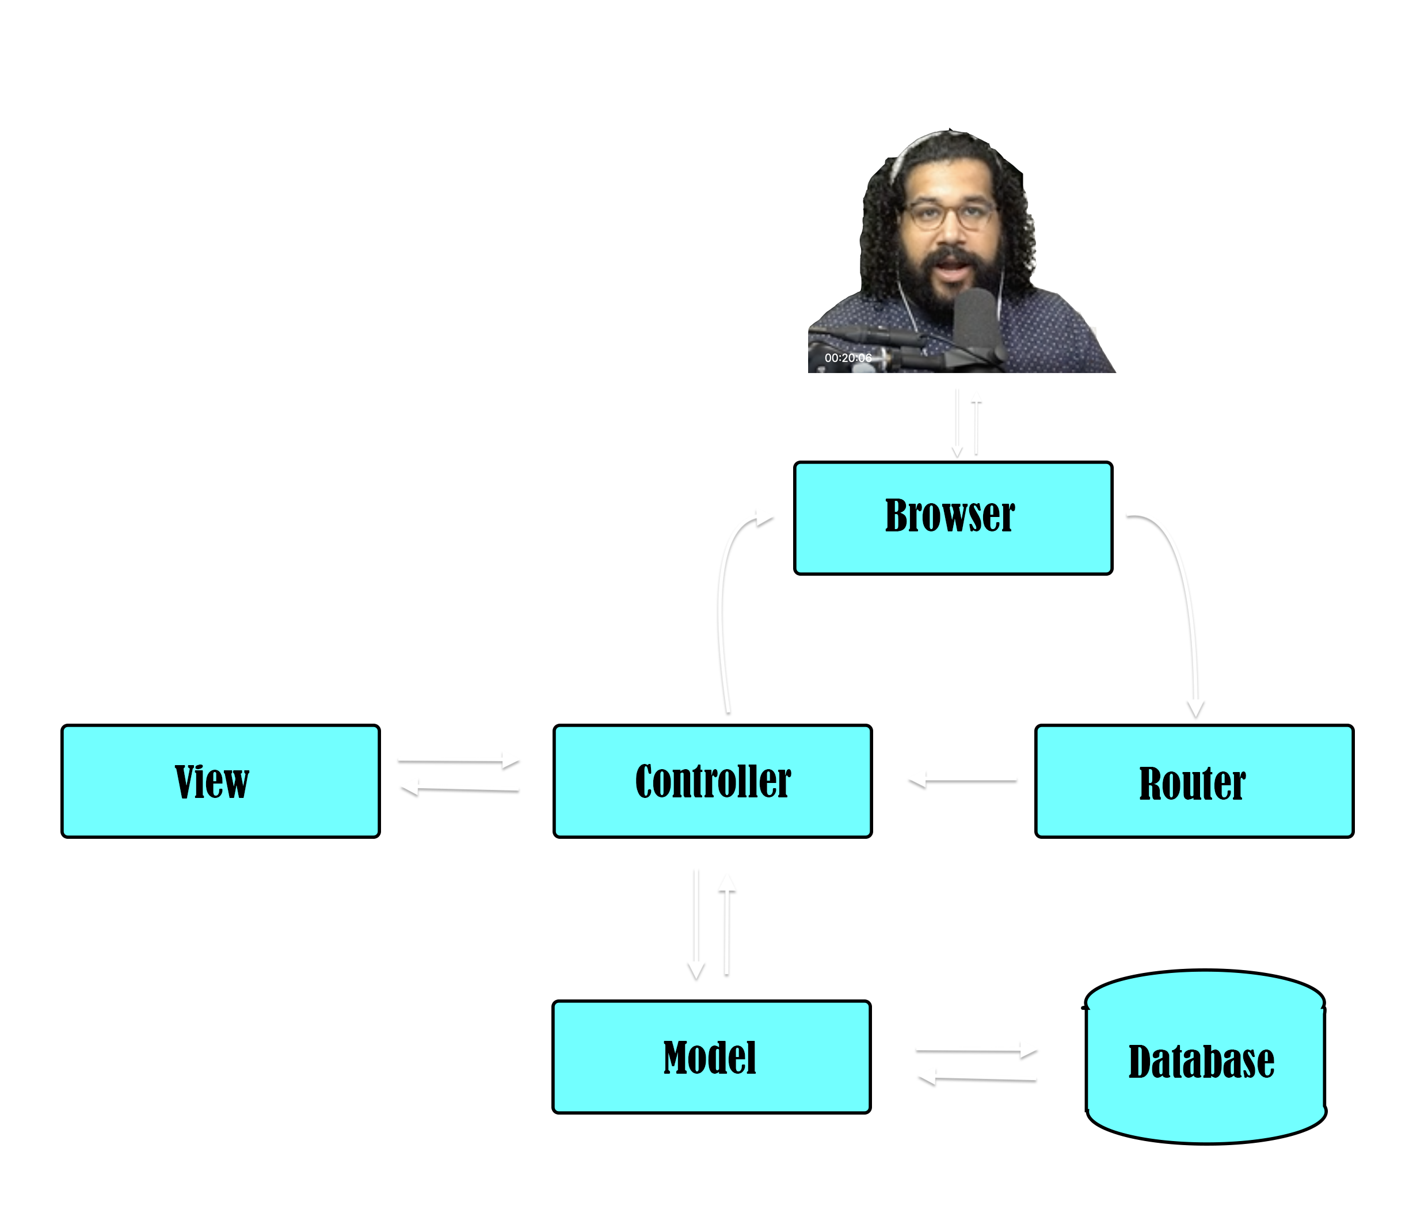
Enter MVC
Or as I like to call it, MVCr (because routers need love too)
MVC is an architecture system for dividing your code into 3 main sections:
Model: Data storage management
View: How the the data/content is represented to the client.
Controller: Manages the interactions between the client and the other sections of MVC

Slide 7
Model
The model determines the interface used to access data.
Through the use of Schemas, specify what the data coming in and out of of the data store should look like.
Schema’s can be used to type-set and validate data

Slide 8
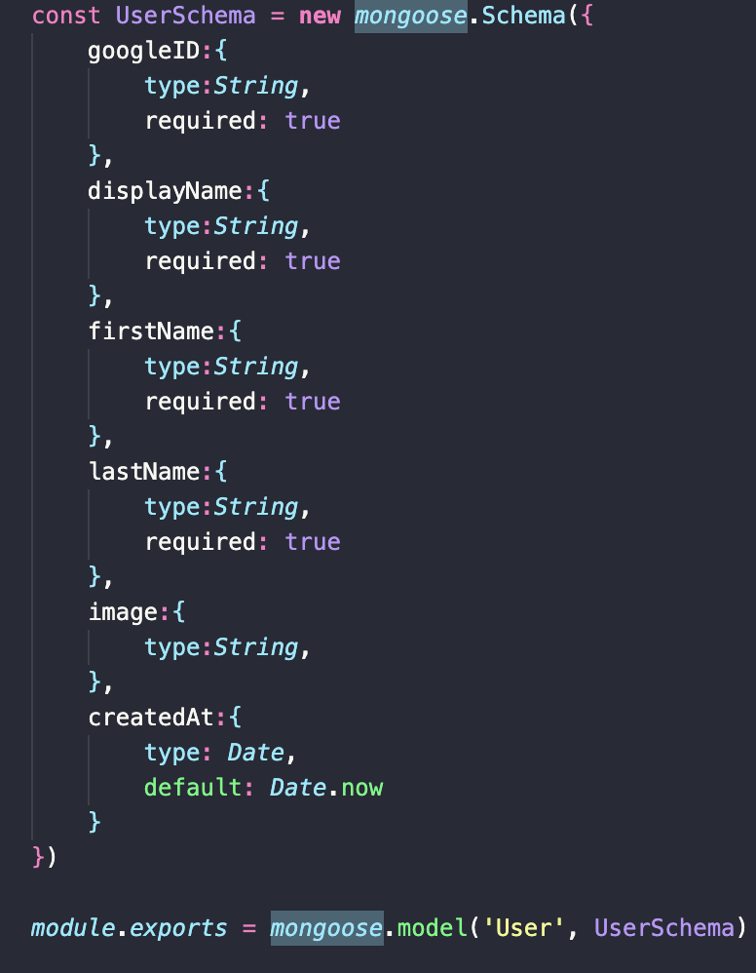
Model - Schemas
In the example to the right, the mongoose UserSchema is saying that user data requires things:
googleID string,
displayName string,
firstName string,
lastName string.
It can also have, but not required:
Image string (presumably an URL to an image file)
createdAd date, which would be assumed to be now (relative to creation time) if unless otherwise specified

Slide 9
Model pt. 2
This all gives us 3 things:
If we add more request data from our data store, we know exactly what it looks like
Our controller developers can interact with the data store (through the model) without knowing anything about how the data store is implemented. Is it Mongo? SQL? Postgres? ¯\_(ツ)_/¯
Because models are stored separately from the controller and the views components, we know right where to look if we need to change them

Slide 10
View
The view component is responsible for taking the model data that’s been given to it by the controller and presenting it to the end user.
The view is commonly handled by a rendering engine like EJS, React, or Handlebars
Rendering engines add in programmatic functionality to what would be otherwise static HTML because there’s often no way to know how much data the model will serve up. The view has to be able to REACT ;) accordingly.

Slide 11
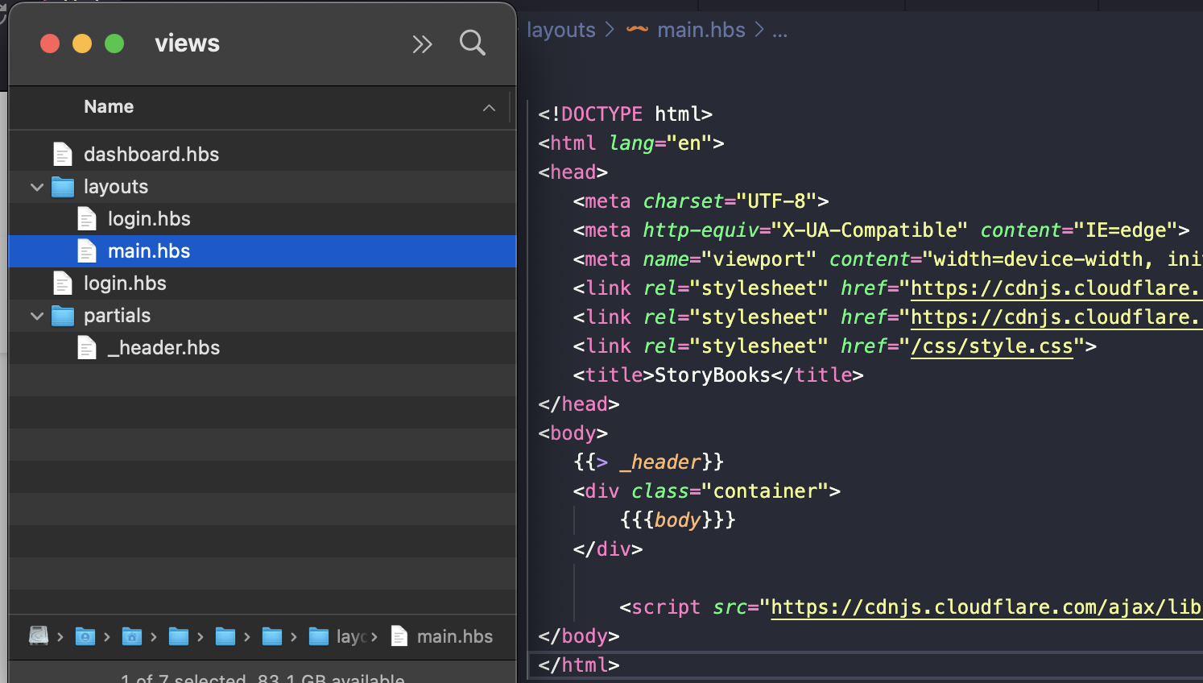
View pt. 2
Again, the views have their own separate space in our codebase. Making changes to what the user sees can be done without affecting the model or controller components
The view templates (.hbs files ->) can specify general HTML with additional logic to handle data.
These templates can also be snippets (partials) that can be imported into other templates for reusability

Slide 12
View pt. 3
Views gives us:
The ability to manage what we send to the client without having to worry about listening to routes or pulling data from a datastore.
Our controller developers can send data to the view components (from the model) without knowing anything about how that data is going to be rendered. Is it EJS? React? Handlebars? ¯\_(ツ)_/¯
A separate place for the code we send to the client so it can now be edited without affecting the other parts.

Slide 13
Controller
In so many words, the controller is what’s left when you pull the view and model components from the monolithic server.js you know and love.
The controller listens to incoming requests and, based on those requests, coordinates the interaction between the datastore (model) and what is ultimately seen by the client (view).
In the examples on the next few slides, we’ll be using express as our controller.

Slide 14
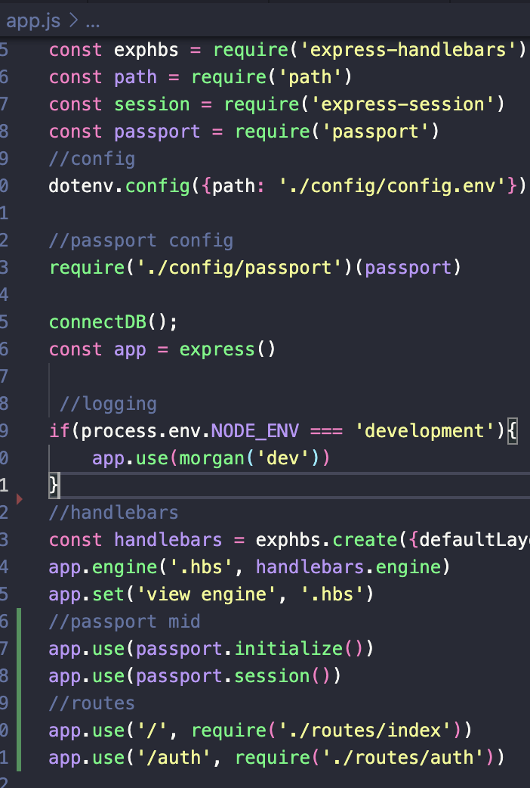
Controller pt. 2
Here, we have our main app.js where you can see it requiring handlebars (view), passports (model), and files from our ./routes folder to perform a few operations using them. Again, this is because the controller acts as the facilitator between the view, the model, and the client.

Slide 15
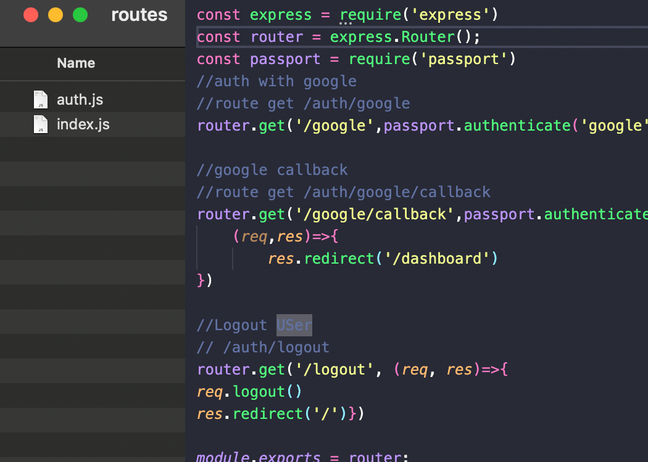
Controller - router
The controller’s routes define all the different ways the client can interact with out site via the URL. The number of routes our site can support can get very large, so they too have their own spot in our codebase, the routes folder
Even within these individual route files, we can see the controller interacting with each layer, using passport to authenticate and save to our datastore and redirecting to different routes, where the view’s rendering engine gets called to render those pages.

Slide 16
Controller pt. 3
Controller gives us:
The ability to centrally manage access to the different parts of our site, letting the client, view, and model all talk through it.
Our model and view developers can customize how they store an render data without having to worry about how each of the other pieces are implemented. Is the view EJS? React? Handlebars? Is the model Mongo? SQL? Postgres? ¯\_(ツ)_/¯
A separate place for the code we use to interpret routs so it can now be edited without affecting the other parts.

Slide 17
What is MVC?
MVC is a design paradigm that allows us to separate out the main parts of server side code so that it is more modular, manageable, and sharable between a team of developers.
These parts (model, view, and controller) all interact via abstracted interfaces so that one can be modified without the concern of breaking the others.
Finally, it introduces a file structure for our code that Is segmented and logical, making things easier to find and problems easier to debug.

